Slide 1
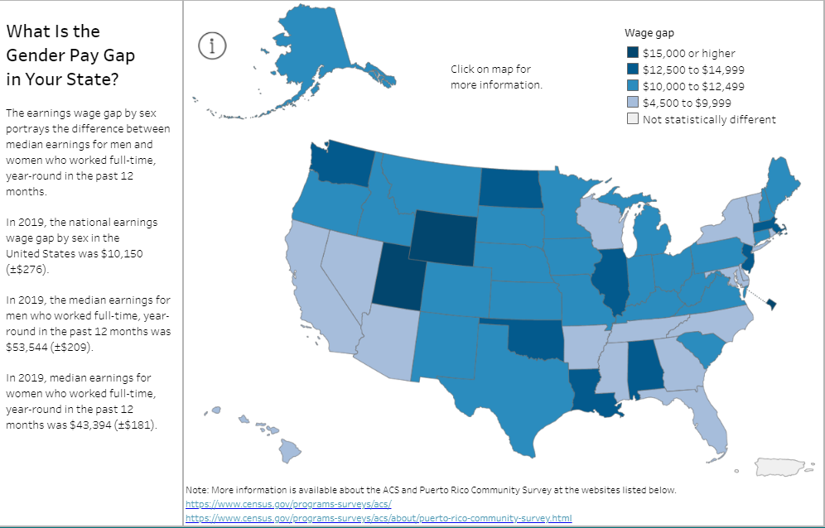
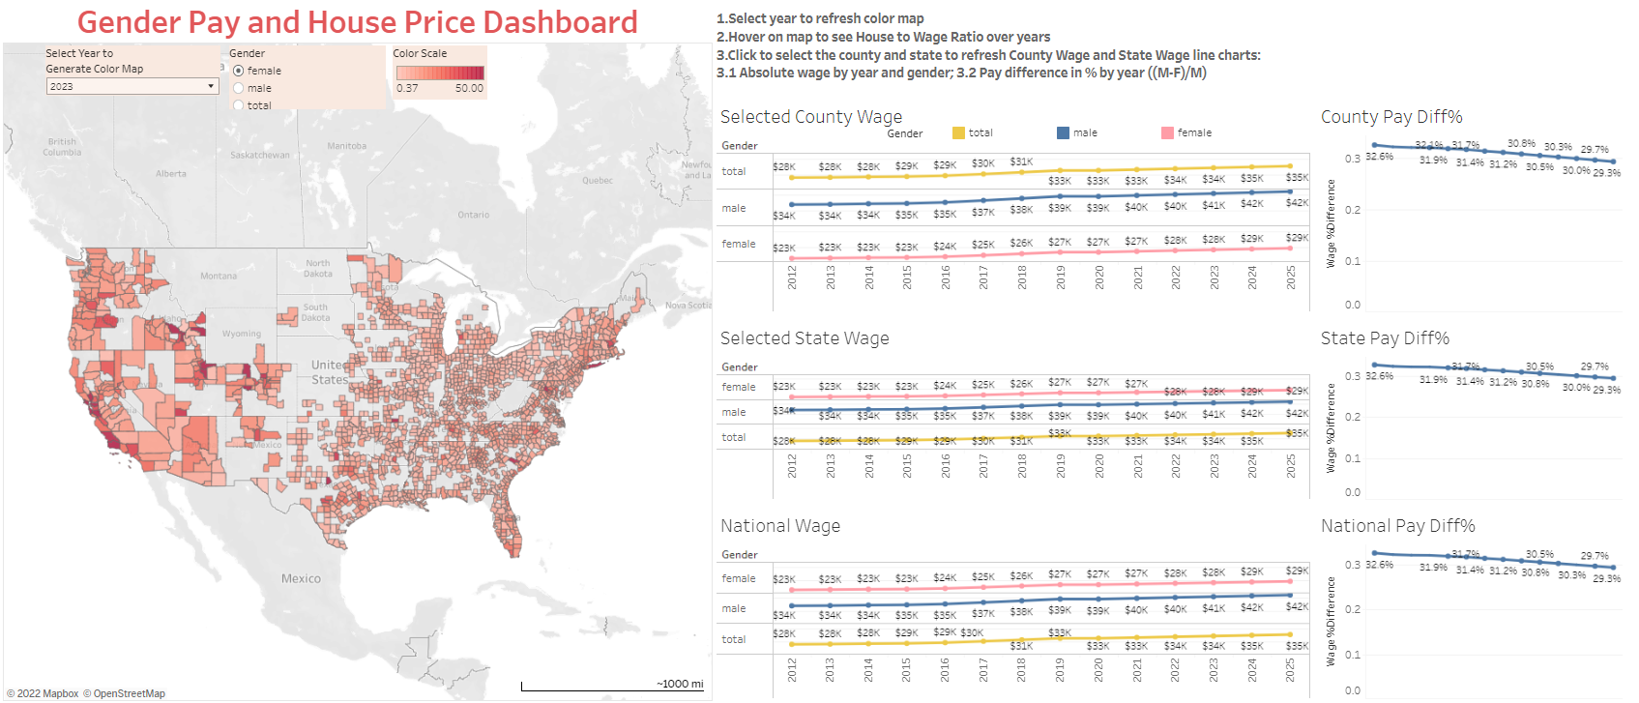
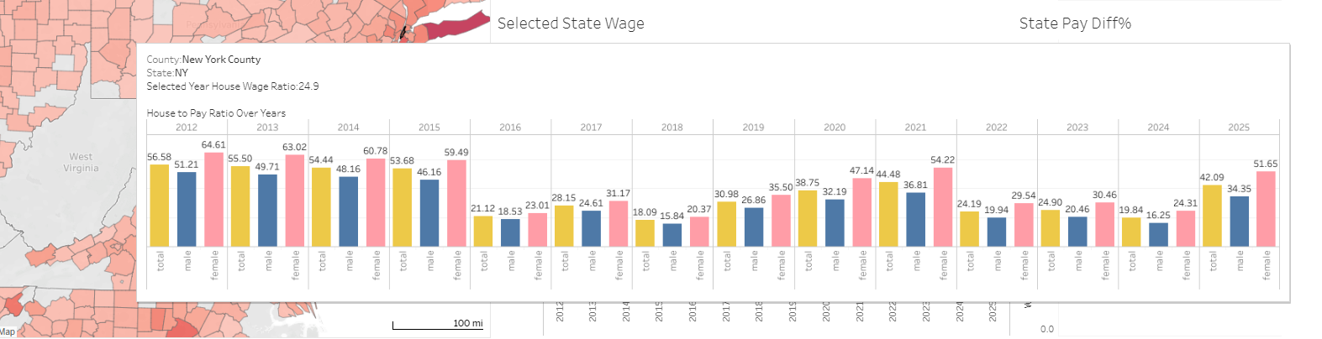
Gender Pay and House Price Dashboard
An interactive dashboard to visualize housing prices and gender pay data
Team 126: Hanna Choi, Xuanming Lin, Xinying Lu, Wei Peng, Jia Wan
Introduction and Motivation
Data Acquisition
Background: Many have studied the gender pay gap (GPG) across different regions and occupations, but few have dived into the multi-faceted impacts of GPG on people’s everyday lives.
Motivation: Our project aims to explore how the GPG can associate with the housing market. Through this project, we developed an interactive and user-friendly dashboard that demonstrates the impacts of GPG using U.S. census data and national real estate data. We used the time-series model to make predictions on the housing market and used regression to predict GPG for the next three years.
We obtained both the zip-code level and county level median earning by sex for the US population from U.S. Census Bureau from 2011 to 2020. We conducted basic data cleaning by removing irrelevant columns and features, filling in missing data with the most recent prior year’s available data, and regulated the geo data. We chose to apply the linear regression model on the time series data over the ten years, which helped us predict the near future income trend by sex for each county.
The home price data is downloaded from Redfin Data Center, which contains 2.46 Gb of home sale records by US zip code since 2012. We cleaned our data by Python using the Pyspark and Pandas packages to fill in the NULL values in the time series with the previous value. we used ARIMA model to predict future home price.
Methods and Innovations
Experiments and Results
Current Gender Pay Gap Dashboard by US Census:
We used Tableau Public to host our dashboard. We tested and evaluated the efficiency, functionality and capability through performance survey.
Performance summary:
Survey Result
24 survey respondents
45.8% of survey responders are male and 50% of them are female
91.7% users claimed the dashboard is easy to use and they learned something interesting or new about the topic
Limitations and future work:
Future studies can be conducted on the gender pay gap by occupation
Visualize the dashboard on a website and add more interactive tooltips and charts
Innovations:
First user-interaction tool of GPG from the view against the reginal home price
Forecasted future home price and gender pay on US county level for the next 3 years
Provided tool-tip summary statistics and charts for home price and gender pay ratio
Allowed for filtering for visualization
Dashboard Showcase
Access the Dashboard: https://public.tableau.com/app/profile/wei.peng8662/viz/Dashboard_16694220545890/Dashboard1?publish=yes

